Slide 1
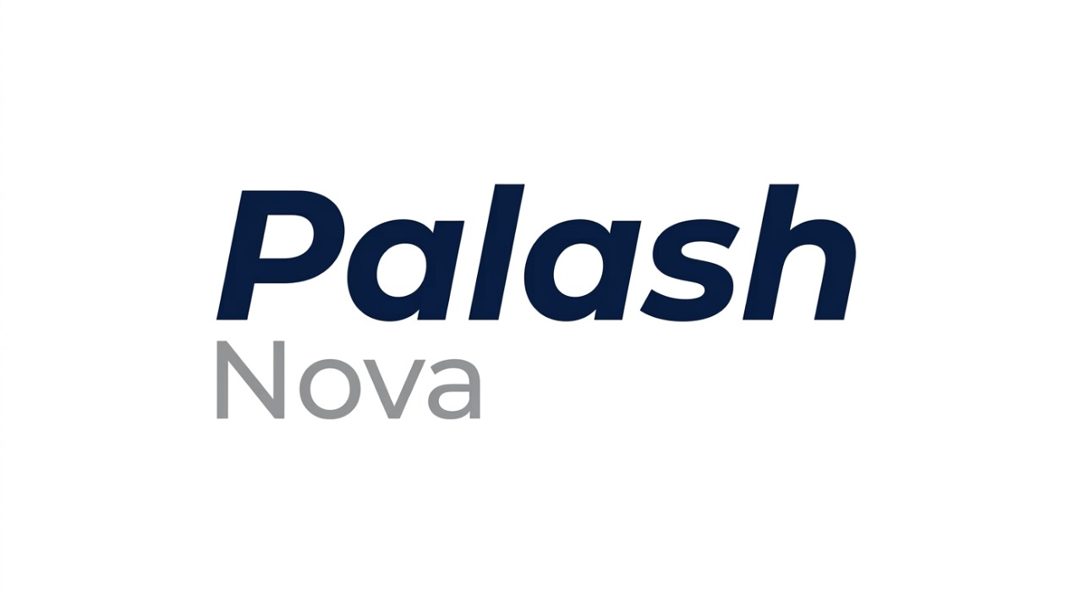

SMART INDIA HACKATHON 2026
Problem Statement ID : 26042
Problem Statement Title: AI-Powered Vernacular Pedagogy &Real-Time Translation for Mother-Tongue Education
Theme: Smart Education
PS Category: Software
Team ID:
Team Name: Palash-Nova
@Palash-Nova
1

Slide 2
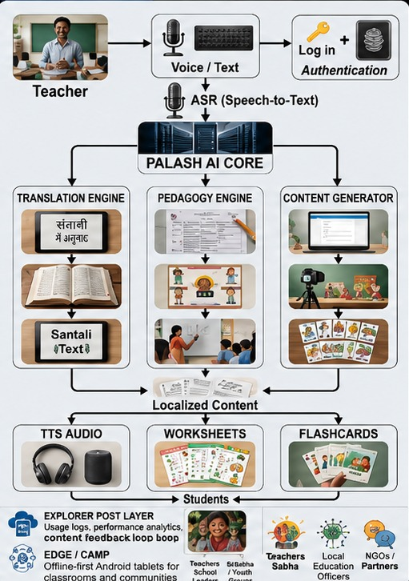
PALASH
PROBLEM EXISTING
Teacher-Language Mismatch: Students struggle to understand lessons when the teacher's language differs from their native language.
Limited NLP Resources: Ho, Mundari, and Santhali lack sufficient digital language datasets and AI/NLP support.
No Reliable Internet Solution: Poor connectivity makes cloud-dependent classroom tools ineffective in remote areas.
ARCHITECTURE
PROPOSED SOLUTION
Offline-First Learning Assistant: Android-based teaching companion designed for low-cost tablets and remote classrooms.
Instant Bilingual Learning: Converts Hindi content into tribal languages with both translated text and synthesized audio.
Real-Time Voice Interaction: Enables Hindi ↔ Tribal language speech communication with a response time target of under 3 seconds.
UVP(UNIQUE VALUE PROPOSITION)
Domain-Constrained Translation: Specialized education-focused translation designed for classroom learning instead of generic conversational AI.
Offline-Ready Learning System: Supports offline inference and downloadable content packs, ensuring uninterrupted use after initial synchronization.
Automated FLN Content Creation: Generates bilingual worksheets, visual flashcards, and learning materials aligned with Foundational Literacy & Numeracy (FLN) outcomes.
@Palash-Nova
2

Slide 3
@Palash-Nova
3

Slide 4
FEASIBILITY AND VIABILITY
FEASIBILITY
VIABILITY
Classroom Translation: Hindi ↔ Tribal language text translation for educational content is technically feasible with existing NLP and MT technologies.
Offline Android Deployment: Compact and quantized AI models can run on low-cost Android tablets without continuous internet access.
Real-Time Voice Interaction (<3s): Achievable for a controlled classroom demo with limited vocabulary and domain-specific content, but challenging for open-ended conversations.
Market Need: Millions of tribal-language students face learning barriers due to teacher-language mismatch, creating a strong demand for inclusive educational technology.
Policy Alignment: Supports NIPUN Bharat, National Education Policy (NEP) 2020, Digital India,multilingual education initiatives.
Cost Efficiency: Operates on affordable Android tablets & functions offline, minimizing infrastructure connectivity costs.
Scalability: New tribal languages, content packs, and curriculum modules can be added incrementally without major platform changes.
Long-Term Impact: Improves foundational literacy outcomes while preserving and promoting indigenous languages through digital education.
DATA AVAILABILITY
FLN Content Sources: NIPUN Bharat and Foundational Literacy & Numeracy (FLN) materials provide publicly available educational content for alignment.
Open NLP Resources: AI4Bharat offers Indic language datasets and machine translation resources, including support for Santali.
Speech Data Collection: Bhashadaan can be leveraged to gather speech, transcription, and translation datasets.
TECHNICAL CHALENEGES
Risk: Limited datasets, dialect variations, device constraints, and children's speech variability affect accuracy.
Mitigation: Quantized offline models, speech fine-tuning, teacher corrections, confidence checks, and dataset expansion.
@Palash-Nova
4

Slide 5
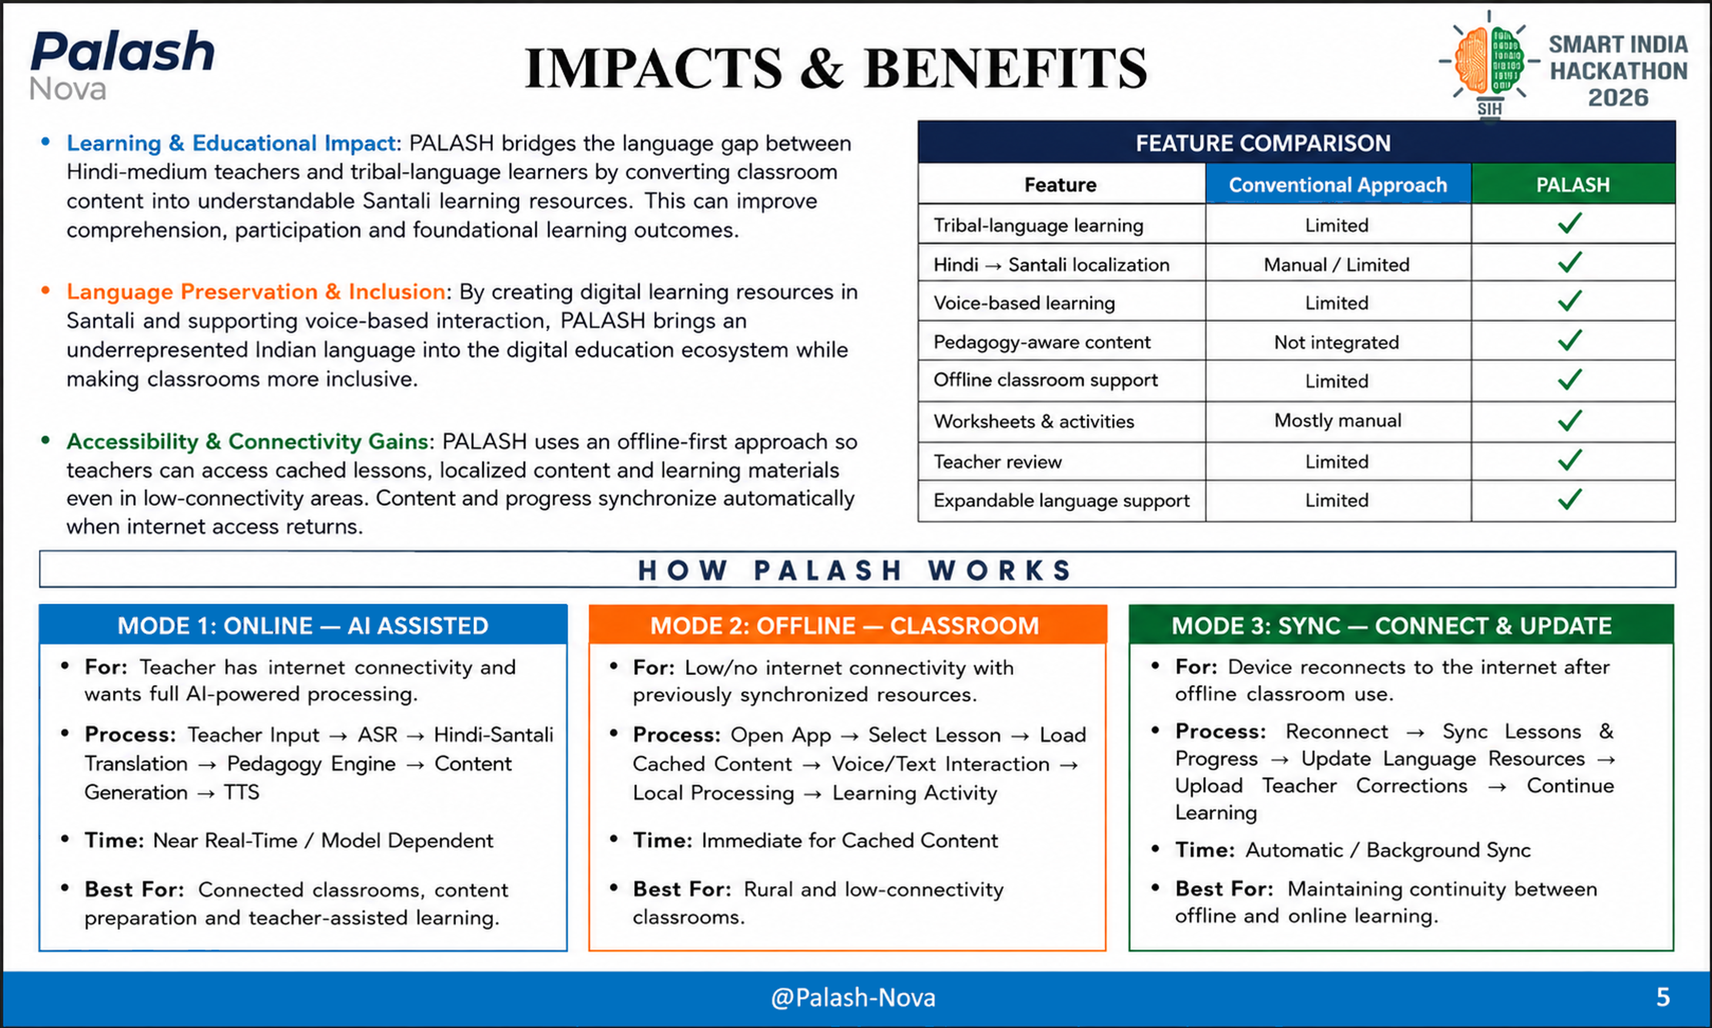
@Palash-Nova
5

Slide 6
RESEARCH AND REFERENCES
RESEARCH & TECHNICAL FOUNDATION
Low-Resource Santali NLP: Limited data, script, and morphology challenges; improved MT resources are still needed.
Santali Machine Translation: Fine-tuned IndicTrans2 outperformed ByT5, showing effective multilingual transfer learning.
Santali Speech Recognition: Whisper-based cross-lingual transfer enables Santali speech recognition in the Ol Chiki script.
Reference: ACL Anthology
https://aclanthology.org/2025.mmloso-1.14/
Reference: ACL Anthology https://aclanthology.org/2025.mmloso-1.9/
Reference: ACL Anthology https://aclanthology.org/2025.findings-ijcnlp.16/
EXISTING SOLUTIONS / TECHNOLOGIES
BHASHINI / Anuvaad: Government-backed multilingual text, speech, and translation platform.
IndicTrans2 & NLLB-200: Multilingual translation models supporting Indian and low-resource languages.
Whisper & MMLoSo: Speech recognition and research initiatives for low-resource tribal languages, including Santali.
WHY PALASH STANDS OUT
Education-Focused: Maps grade, subject, and learning outcomes to classroom-ready content.
Offline, Voice & Teacher-Centric: Supports offline use, voice/text input, and teacher-reviewed outputs.
Beyond Translation: Generates learning resources and supports scalable multilingual expansion.
PROJECT RESOURCES/REFERENCES
1.BHASHINI / Anuvaad https://anuvaad.bhashini.gov.in/
2.A14Bharat / IndicTrans2
https://github.com/AI4Bharat/IndicTrans2
3. NLLB-200 (Meta)
https://ai.meta.com/blog/nllb-200-high-quality-machine-translation/
4. MMLoSo 2025 Shared Task (Machine Translation into Tribal Languages)
https://aclanthology.org/events/mmloso-2025/

